Slide 1

Statistical challenges—Measurement, outcomes, multicomponent intervention
Heather Allore PhD
Yale School of Medicine & School of Public Health

Slide 2
Knowledge Gap Related to Treatment of Patients with Multiple Chronic Conditions
Department of Health and Human Services published (2010) “Multiple Chronic Conditions: A Strategic Framework” outlining strategies for addressing health needs of affected patients.
Gap 1: Methods for identifying chronic disease clusters
Gap 2: Develop coordinated care management strategies
Given the expanding availability of treatments designed to treat persons with MCC
Gap 3: Develop studies designs and methodologies to understand how treating the disease of interest might be related to the presence of co-existing diseases.
(Boyd CM, Darer J, Boult C, Fried LP, Boult L, Wu AW. Clinical practice guidelines and quality of care for older patients with multiple comorbid diseases: implications for pay for performance. JAMA. 2005;294:716-24.)

Slide 3
Patient-Centered Outcomes Research Institute: Methodology Report (2013)
PCORI’s 47 standards fall into 11 categories, 5 are relevant to most PCOR studies.
• Formulating research questions
• Patient-centeredness
• Data integrity and rigorous analyses
• Preventing and handling missing data
• Heterogeneity of treatment effect

Slide 4
PCORI Methodology Report (2013)
6 apply to particular study designs and methods.
4 apply to studies that have varying designs and purposes.
• Causal inference methods for observational studies
• Adaptive and Bayesian trial designs
Strategies to Reduce Injuries and Develop confidence in Elders (STRIDE)
PCORI/NIA multi-site cluster randomized clinical trial (RCT) of an evidence-based, multifactorial individually-tailored intervention to reduce the risk of serious fall injuries among non-institutionalized older persons.

Slide 5
STRIDE
Collaboration among 14 Claude D. Pepper Older Americans Independence Centers; 10 healthcare systems where patients will be recruited, and patients and other key stakeholders.
Implemented as a pragmatic clinical trial that will occur in the context of routine clinical practice and the assessments and interventions are based upon information needed to make a clinical decision.
Implementation of the falls risk assessment and interventions are operational differently based on the patient panel size, practice resources, available community programs, patient preferences and reimbursement resources for interventions.
Falls care managers and the providers of the physical intervention will be practicing clinicians in diverse settings (e.g., primary care practices, home health, outpatient clinics, and community programs).
Dissemination and implementation of the assessment and interventions need to be adapted to the local context and consistent with patient preferences.

Slide 6
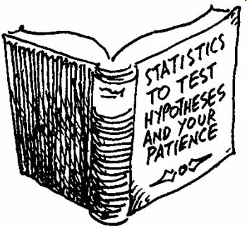
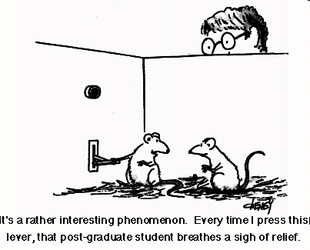
Study Design

Slide 7
Trial Designs
Variety of trial design each with characteristic features:
  Single treatment, homogeneous sample patient RCT
  Single treatment, heterogeneous sample pragmatic CT
  Multiple treatment, homogeneous sample patient RCT
    Full Factorial if all are at risk of every treatment
  Multiple treatment, heterogeneous sample
    Sequential, multiple assignment, randomized trial (SMART) designs are being used to construct adaptive interventions
    Standardly-tailored design
    Adaptive
    Platform
    Pragmatic CT

Slide 8
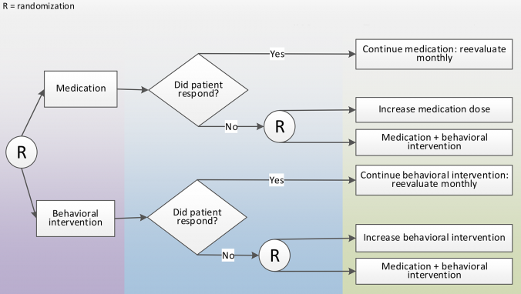
This SMART design is to understand whether to begin with medication or behavioral therapy, and whether to intensify or augment initial treatment for non-responders.
Pelham, W. E., & Fabiano, G.A. (2008). Evidence-based psychosocial treatment for ADHD: An update. Journal of Clinical Child and Adolescent Psychology, 31, 184-214.

Slide 9
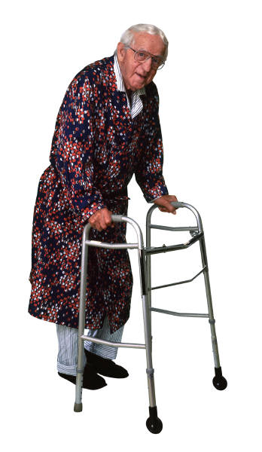
Standardly-tailored Design
Cognitive impairment
Assesses each pre-specified disease and risk factor and assigns a pre-determined intervention component to it. Not all participants have all factors. Better reflects clinical populations.
CHF
Hypertension
DM
Lung Cancer
Hip Fx
Grip strength
Balance
Allore HG et al Clin Trials 2005; 2: 13-21. Allore HG, Murphy TE. Clin Trials 2008; 5:121-130.

Slide 10

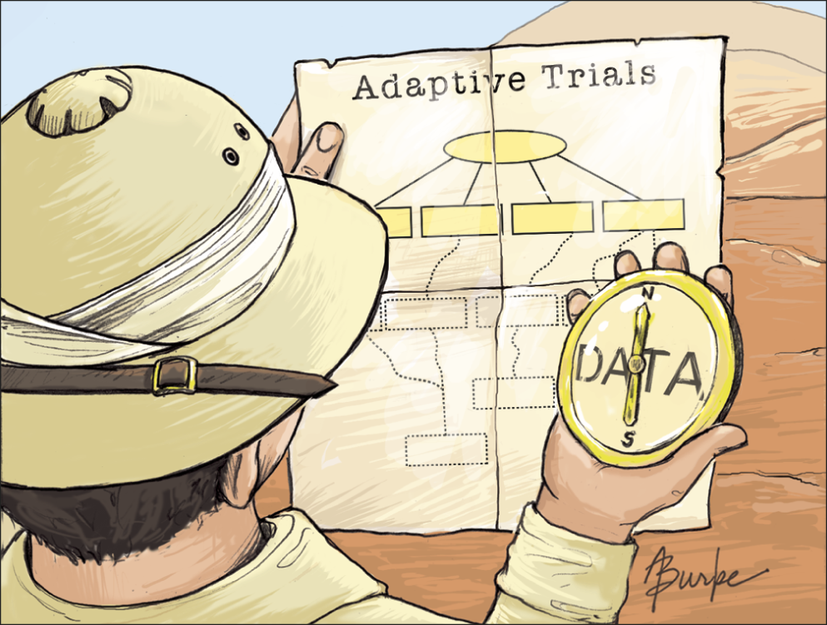
From: Industry, FDA Warm to “Adaptive” Trials
JAMA. 2006;296(16):1955-1957. doi:10.1001/jama.296.16.1955
“The principle difference between adaptive clinical trial designs and traditional designs is that the data in adaptive trials are analyzed on an interim basis and used to dictate the future course of the trial.”
“In an adaptive design, early responses to the doses might be used to alter the number of patients randomized to each group, with patients entering the trial being disproportionately added to dosage groups experiencing the greatest response.”
Pharmaceutical companies and the Food and Drug Administration are considering the use of adaptive clinical trials—studies that are modified while they are in progress, guided by emerging data—as a way to speed new drugs to market.
Date of download: 4/16/2015
Copyright © 2015 American Medical Association. All rights reserved.

Slide 11
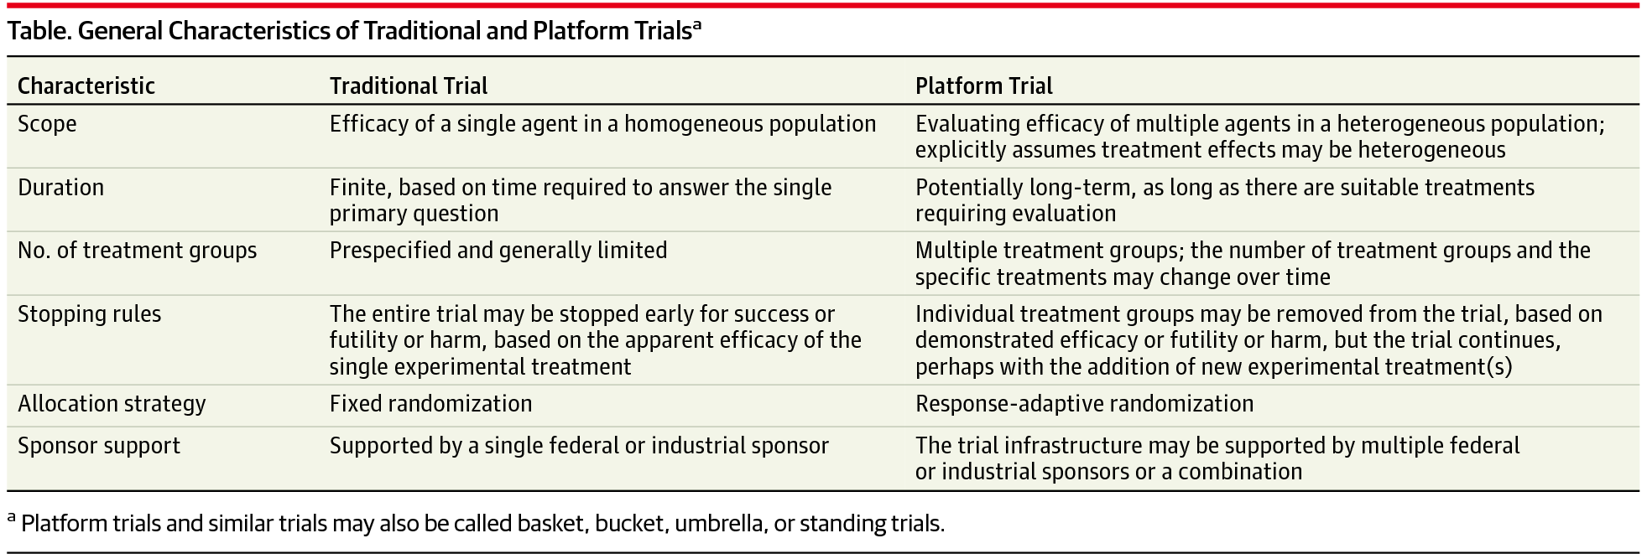
From: The Platform Trial: An Efficient Strategy for Evaluating Multiple Treatments
JAMA. Published online March 23, 2015. doi:10.1001/jama.2015.2316
A platform trial is defined by the broad goal of finding the best treatment for a disease by simultaneously investigating multiple treatments, using specialized statistical tools for allocating patients and analyzing results. The focus is on the disease rather than any particular experimental therapy. A platform trial is often intended to continue beyond the evaluation of the initial treatments and to investigate treatment combinations, to quantify differences in treatment effects in subgroups, and to treat patients as effectively as possible within the trial.
Date of download: 4/16/2015
Copyright © 2015 American Medical Association. All rights reserved.

Slide 12
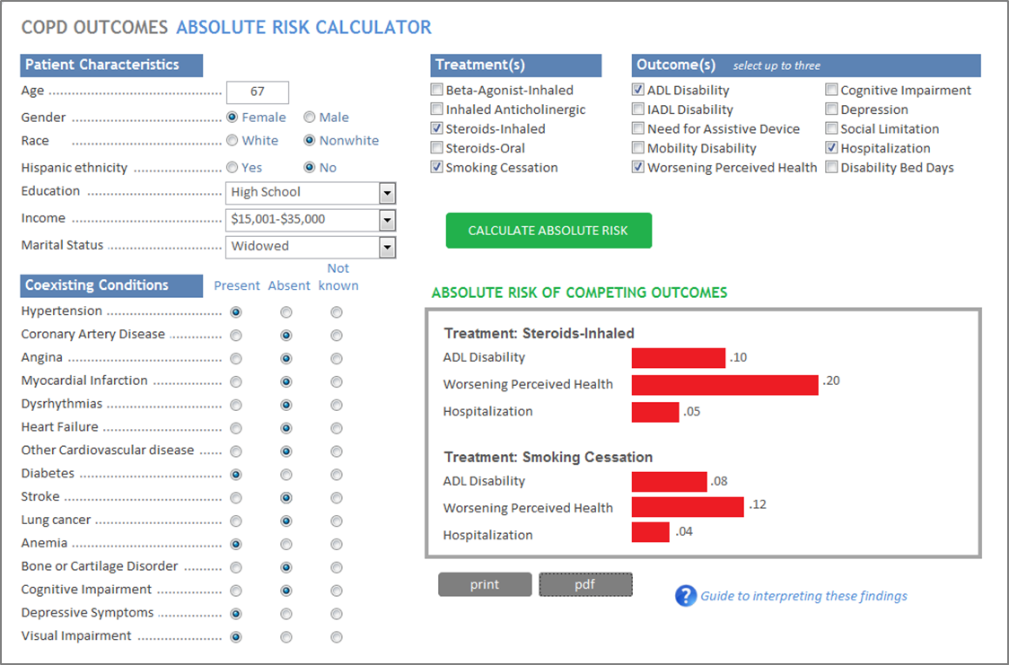
Individualized Absolute Risk Calculator

Slide 13
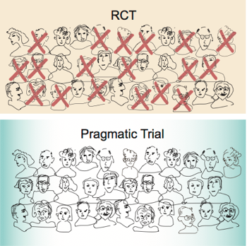
Who is included in a trial?

Slide 14
Methodological Concerns Regardless of Study Design: Missing Data and Competing Risk
Gap: Effective strategies to prevent missing data in trial settings:
  quality control plans to monitor and minimize missing data;
  maximizing benefits and minimizing burdens of participants;
  seeking input from stakeholders to address infeasible measures;
  anticipating the increased resources needed to maintain participants with health and functional problems in the trial or study.
Gap: Designs and models for death (a competing risk) and loss to follow-up increase with age.
Gap: Cognitive or physical deficits can lead to inability to perform some assessments, use reliable proxy or alternative measures.
Missing data can bias results, reduce power, and reduce generalizability, reducing both the internal and external validity of study results.

Slide 15
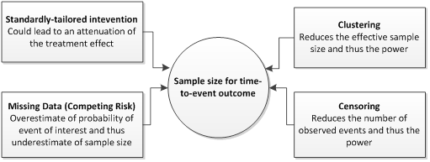
Gap: Sample Size Estimation not Available for all trial designs
Impacting of ignoring the components of the study design on sample size estimation

Slide 16
Trial Outcomes - Different Designs
Difference in outcome for all randomized subjects – intent to treat, outcome collected on all randomized
Difference in outcome in toleraters – active run-in, and placebo washout prior to randomization to determine toleraters, outcome collected on all randomized
Difference in areas under the outcome curve during adherence to treatment – no need to collect outcome after trt discontinued
Difference in outcome during adherence to treatment – outcome is end of trial or end of adherence whichever comes 1st. Doesn’t distinguish between highly effective but toxic trt from nontoxic trt with gradual improvement.
Prevention and Treatment of Missing Data in Clinical Trials 2010 Natl Acad Sci

Slide 17
Using Observations Data for Causal Effect Estimates
Real time treatment studies using registries are beginning to be used Gap: method development would enhance their application.
Use of causal inference methods, such as propensity scoring, creates control group that is well- balanced with the treatment group regarding important covariates. Gap: only for a single treatment that all are at risk of receiving, not multiple treatments with variable likelihood of receipt.
Studies should precisely define medications; establish temporal precedence; address clinical indication and contraindication bias; and adjust for confounding or for the propensity to receive the medication of interest.

Slide 18
Conclusions
Each trial should be designed to have find the answers to questions of importance to patients.
There are many gaps in the methodology and needs for research when conducting trials and studies with older adults and their priorities.
Collaborative research teams with expertise in clinical care and biostatistics are required to address research questions address the effectiveness of treatments for older adults.
We need to address cross-condition patient-centered outcomes most important to older adults’ lives.

Slide 19

Thank You!

