Slide 1
Comorbidity and Multimorbidity: Measurement and Interventions
Holly M. Holmes, MD, MS
Dept of General Internal Medicine

Slide 2
Gaps: Incorporating Concepts of Comorbidity into GA and Interventions
What do we mean when we talk about comorbidity and multimorbidity?
What is the intervention for multimorbidity?
How does illness burden in multimorbidity impact quality of life and functional outcomes in cancer?

Slide 3
Comorbidity measures – what is the what?
Why
What
How
When
The importance of comorbid conditions
In general
Particular to cancer
Commonly used comorbidity indices
Index choice based on study characteristics
Definitions of comorbidity
Generic vs. disease-specific
Situations in which it may be important to measure comorbidity

Slide 4
Measuring comorbidity in cancer
A coexisting medical condition that exists along with an index condition that has implications for an outcome.
No gold standard
Particular importance in cancer
Confounder or mediator of effect
Outcome of interest
Distinguish from toxicity
Sorensen HT. Clin Epi 2013:5 (suppl1):1-2.
Ritchie CS. J Oncol Practice 2011;7:371-4.

Slide 5
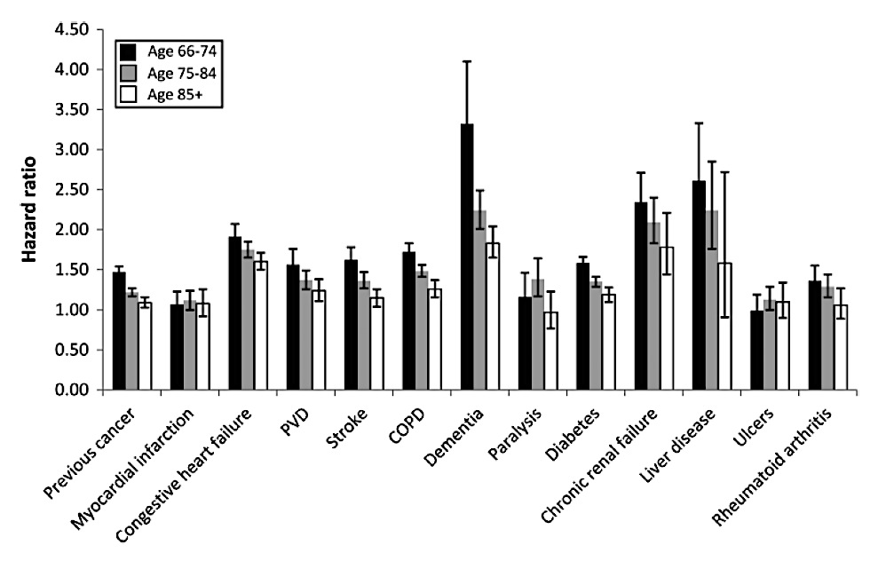
What to measure: individual comorbidities vs. a summated index
Patnaik JL et al. J Natl Cancer Inst. 2011 Jul 20; 103(14): 1101–1111.
Notes:
Figure 1. Adjusted hazard ratios of comorbidities on all-cause mortality, stratified by age category, among breast cancer patients aged 66 years or older, Surveillance, Epidemiology, and End Results–Medicare 1992–2000. The hazard ratios were fully adjusted for race and/or ethnicity, stage category, grade category, estrogen receptor status, surgery, chemotherapy, radiation, and all other comorbid conditions. COPD = chronic obstructive pulmonary disease, PVD = peripheral vascular disease.
This effect was quantitatively similar to the effect seen by stage.
While CCI was associated with survival, previous studies only reported the index score, not individual conditions. There may be meaningful differences between some patients with cancer.
For example, we found that conditions such as liver disease, chronic renal failure, dementia, and congestive heart failure produce the highest hazard ratios of all-cause mortality and that patients with these conditions diagnosed at stage I have survival experiences similar to those of patients with stage III and IV tumors lacking any coexisting disease. Interestingly, in this study, the hazard ratios of all-cause mortality for individual comorbidities differed somewhat from the weights assigned to each comorbidity in the Charlson Comorbidity Index Score.

Slide 6
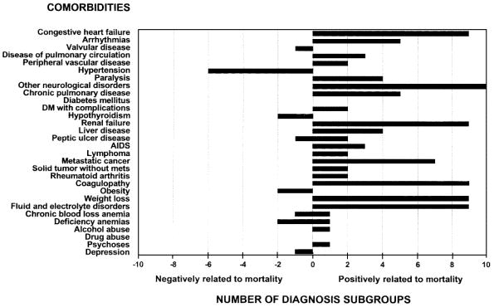
Use your index properly…
Developed to be predictive of length of stay, hospital charges, and in-hospital mortality
Independent effects of conditions >> do not simplify into an index
Elixhauser, Med Care 1998 Jan;36:8-27.

Slide 7
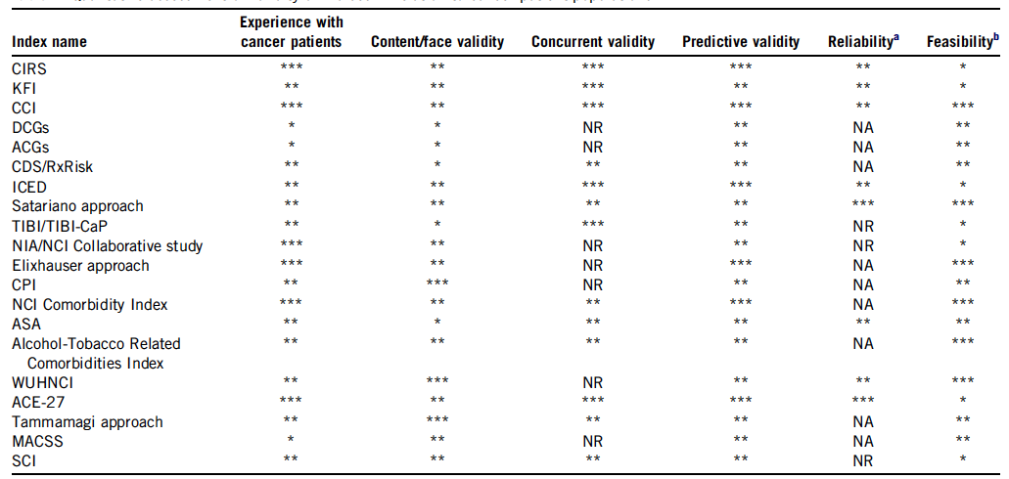
How to measure comorbidity? Depends on the study question, data sources, population.
Some key considerations when selecting a useful comorbidity scale in patients with cancer.
Sarfati, J Clin Epi 2012; 65: 924-33.

Slide 8
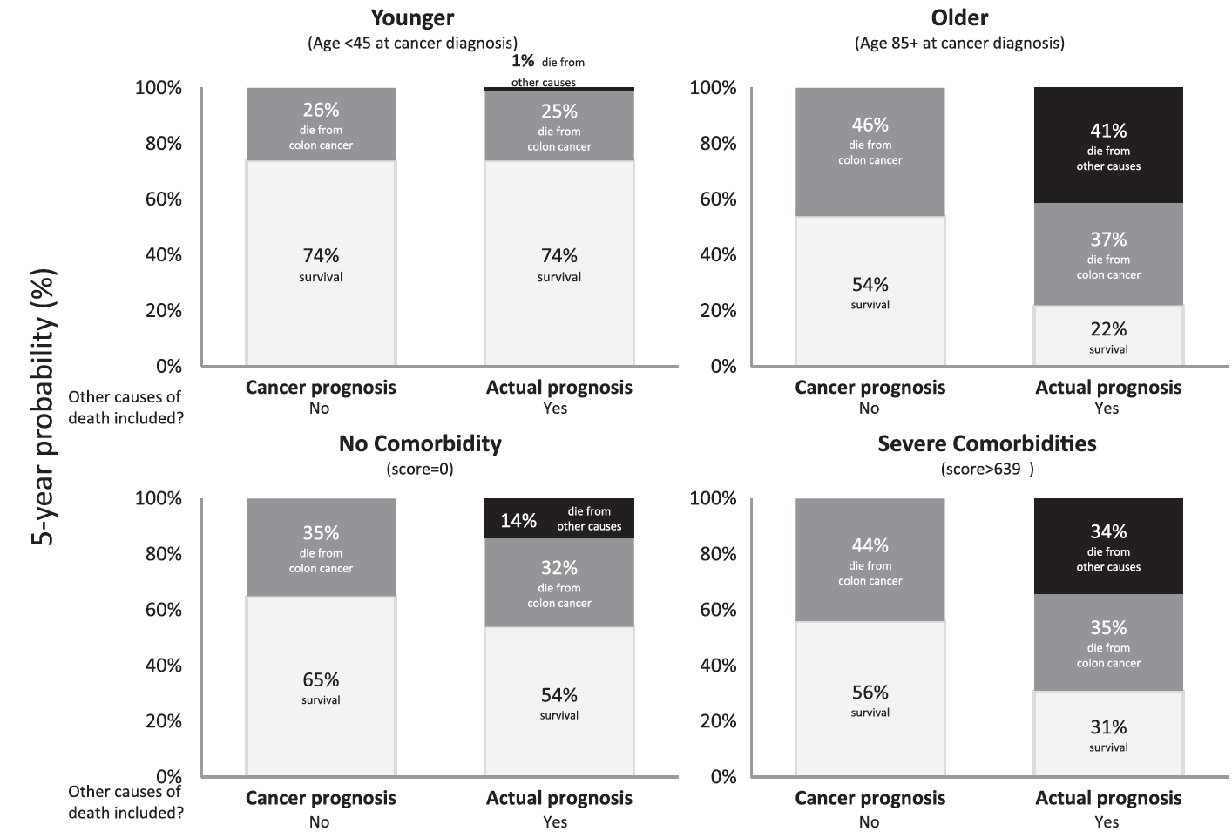
Comorbidity and Prognosis
Howlander, JNCI Monographs, 2014;49:255-264

Slide 9
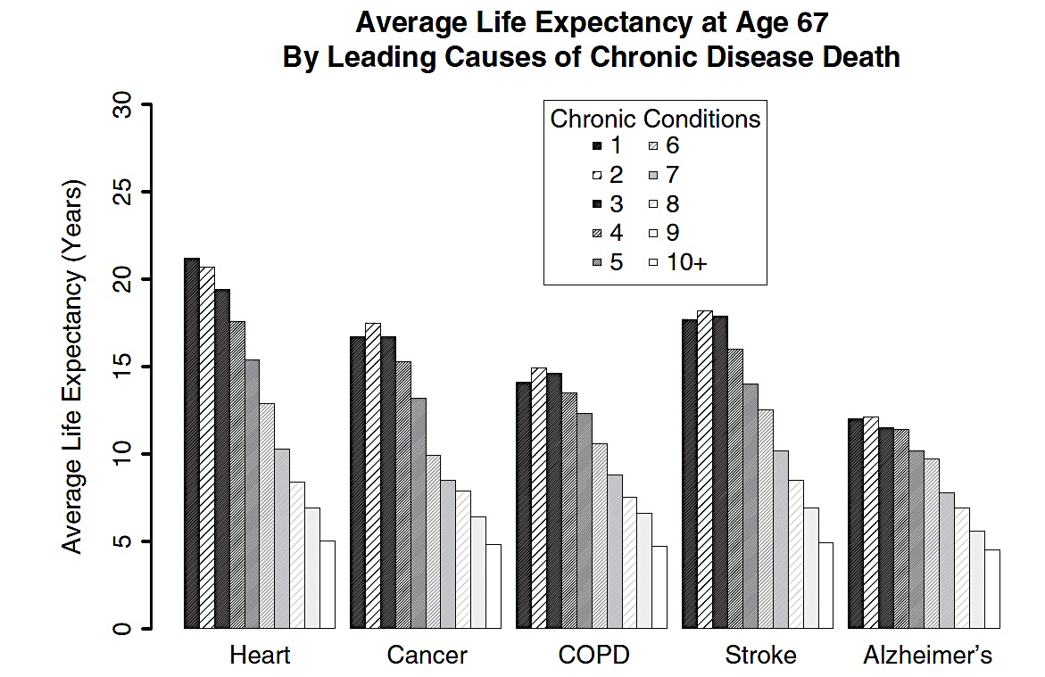
Impact of Number of Chronic Conditions on Life Expectancy
DuGoff EH, et al. Med Care 2014;52:688-94.
Notes:
figure: average life expectancy among individuals with selected conditions by numbers of chronic conditions at age 67, 2008. From Medicare beneficiary summary file and CCW file.

Slide 10
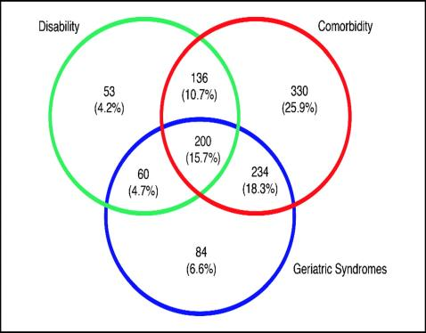
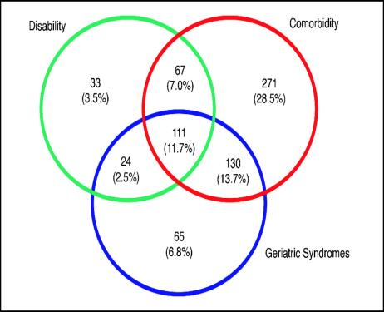
Comorbidity ≠Disability ≠Geriatric Syndromes
Colorectal Cancer
Breast Cancer
Colorectal Cancer
Breast Cancer
Koroukian, S. M. et al. J Clin Oncol; 24:2304-2310 2006

Slide 11
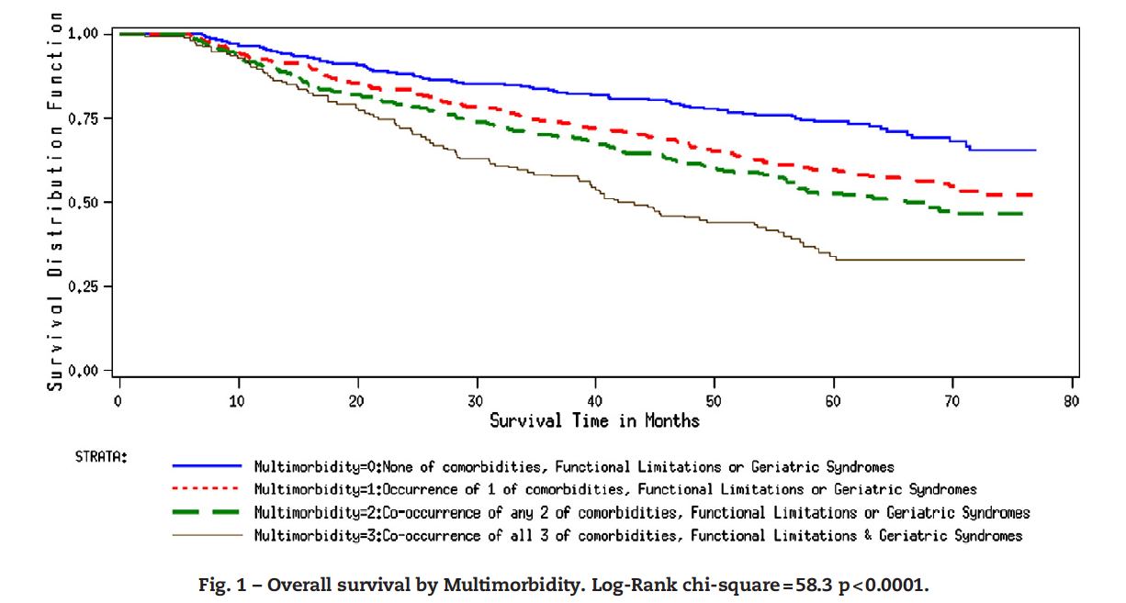
What is Multimorbidity?
Koroukian S, et al. J Geriatr Oncol 2011;2:200-8.

Slide 12
More than half of people 65 and older have 3+ chronic conditions
Comorbidity
Multimorbidity
Comorbid
Disease
Condition
Condition
Condition
Index
Disease
Comorbid
Disease
Comorbid
Disease
Condition
Patient
Boyd, CM, Fortin M. Public Health Reviews, 2011.
Notes:
Increased risk of:
Death
Institutionalization
Increased utilization of healthcare resources➔80% of Medicare funds are spent on patients with four or more chronic conditions
Decreased quality of life
Higher rates of adverse effects of treatment or interventions

Slide 13
Importance of Multimorbidity
Increased risk of:
Death
Institutionalization
Increased utilization of healthcare resources
Decreased quality of life
Higher rates of adverse effects of treatment or interventions
Almost all existing “guidelines” have single disease focus
Best approaches to decision-making and clinical management of older adults with multimorbidity remain unclear
Brendan Smialowski (NY Times)
AGS Expert Panel on the Care of Older Adults with Multimorbidity. J Am Geriatr Soc 2012;60:1957-68
Notes:
The “big deal” slide. Emphasize that this is what geriatric health providers do everyday, struggle with everyday.

Slide 14
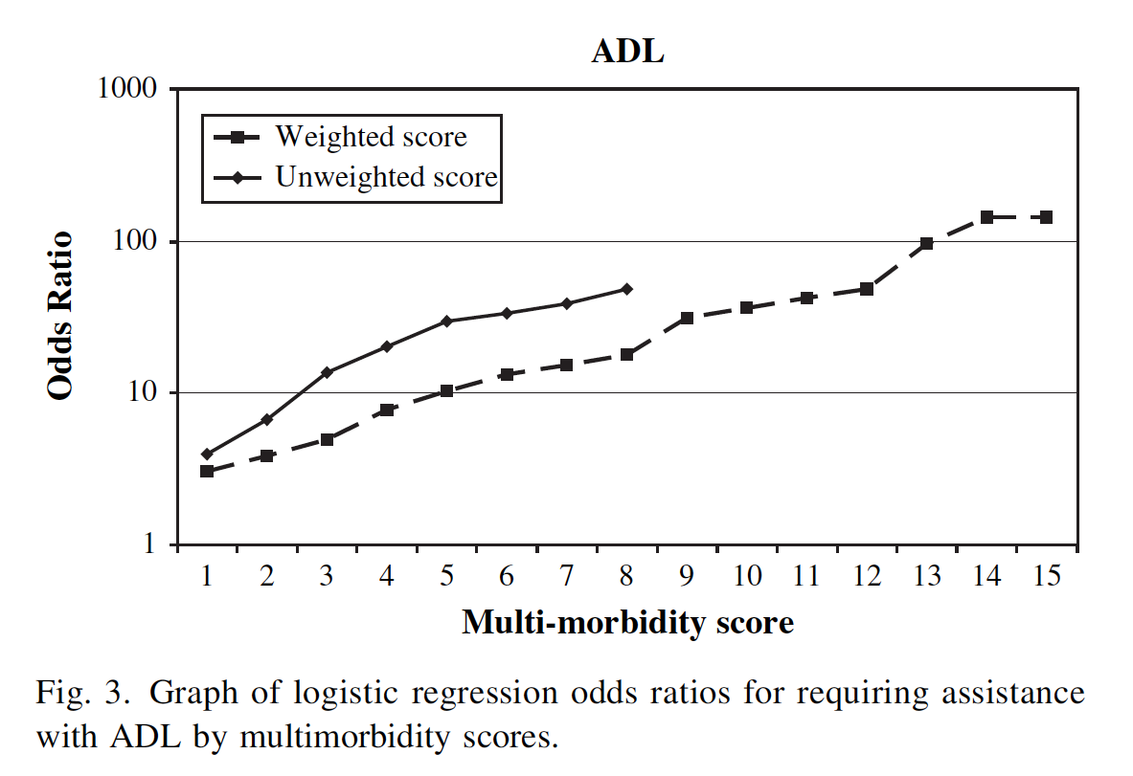
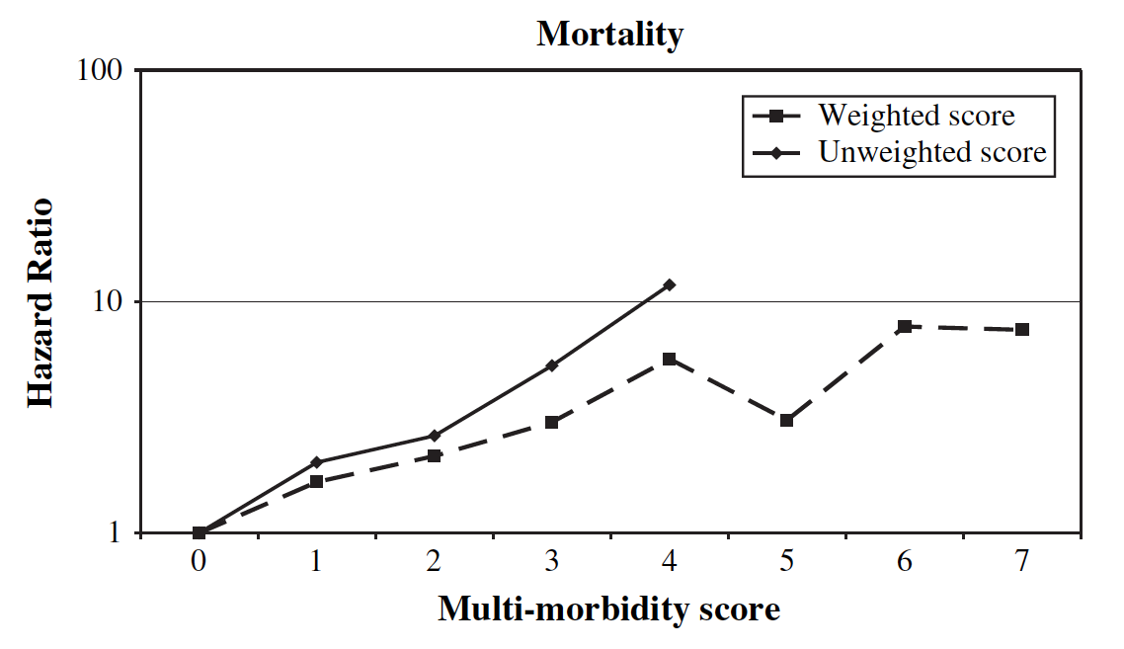
How do you measure multimorbidity?
Tooth L, et al. J Clin Epi 2008;61:151-59

Slide 15
AGS Guiding Principles as an intervention for multimorbidity?
Patient Preferences: Recognize preference-sensitive decisions
Interpreting the Evidence: Embrace uncertainty
Prognosis: Incorporate multimorbidity-adjusted prognosis
Treatment Complexity and Feasibility: Think about complexity and feasibility
Optimizing Therapies and Care Plans: Carefully balance benefits and harms
AGS Expert Panel on the Care of Older Adults with Multimorbidity. J Am Geriatr Soc 2012;60:1957-68

Slide 16
How does multimorbidity impact cancer treatment and survivorship?
Benefits and harms
Treatment burden
Symptom burden
Decision making
Ritchie CS et al. J Oncol Practice 2011;7:371-4

Slide 17
Overcoming the gaps in multimorbidity
Can we standardize comorbidity/multimorbidity assessment in GA trials?
Can we define multimorbid patients with cancer and consider the impact on treatment decision-making, quality of life and survivorship?
Can the guiding principles for multimorbidity be operationalized as an intervention in GA trials?
What are the optimal designs, outcome measures, and statistical methods for trials in multimorbid patients?

