Slide 1
Geriatric Assessment and Interventions for Older Cancer Patients:
Past, Present, Future
Harvey Jay Cohen, MD
U13 Conference
May 13, 2015

Slide 2
GEM Early Stirrings
Models of Geriatric Care in UK in 30’s-40’s
US awareness – 1970’s; elderly complex,
multifaceted issues
Many issues not uncovered in routine evaluation
- Kanes’ book – 1981
Hospitalized older patients at risk for Functional Decline

Slide 3
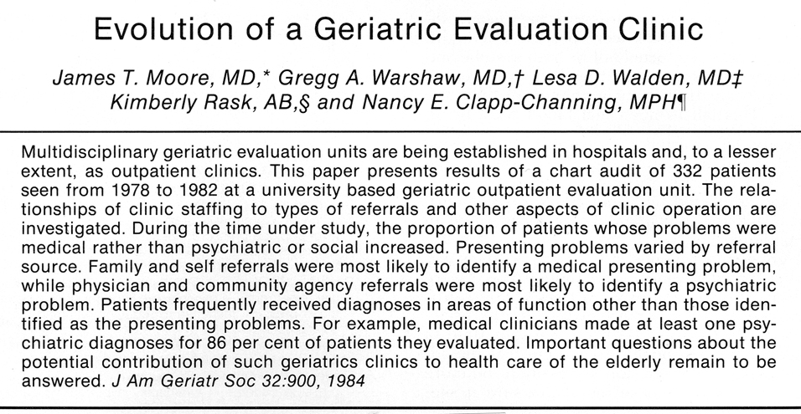

Slide 4
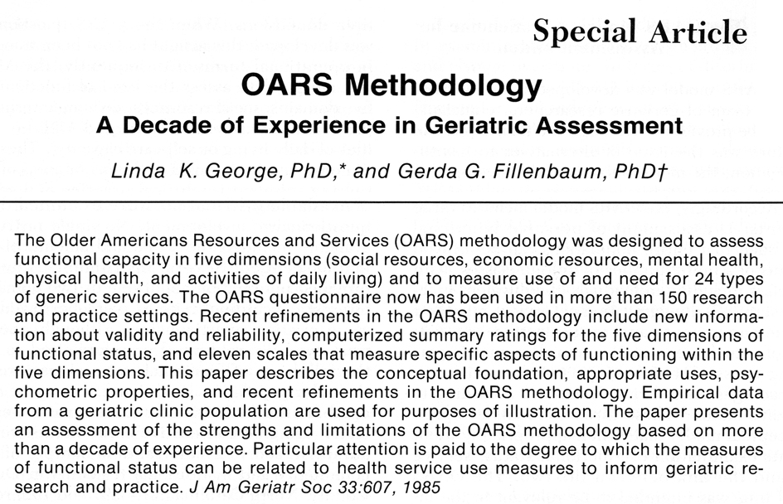

Slide 5
ASSESSMENT OF THE ELDERLY PATIENT
Medical
Cognitive
Affective
Functional
- Physical
- Social
Economic
Social support/caregiver
Environmental
Quality of life/well-being

Slide 6
GOALS OF GERIATRIC ASSESSMENT
Improve Diagnostic Accuracy
Guide Selection of Interventions
Recommend optimal environment
Predict outcomes
Monitor clinical changes

Slide 7
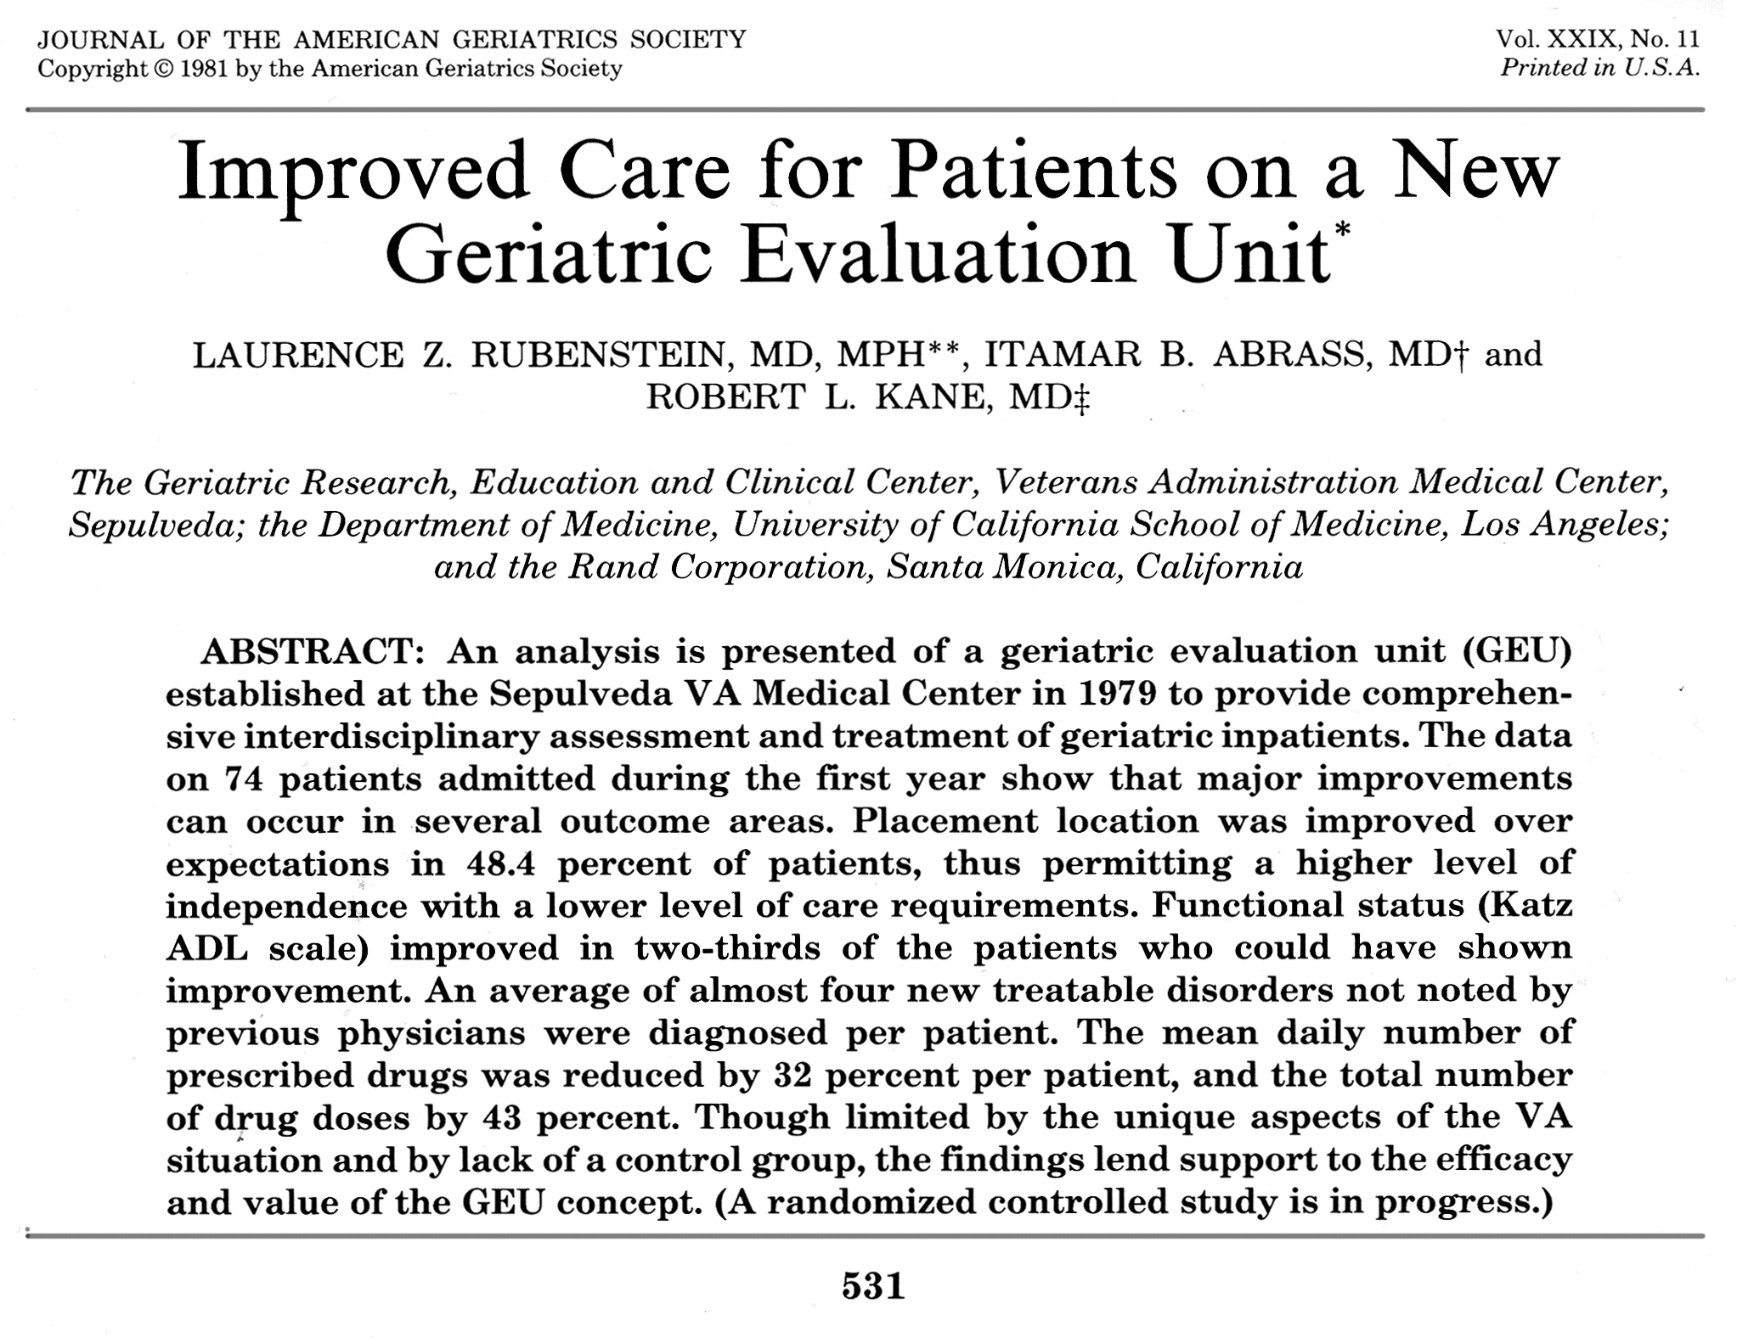

Slide 8
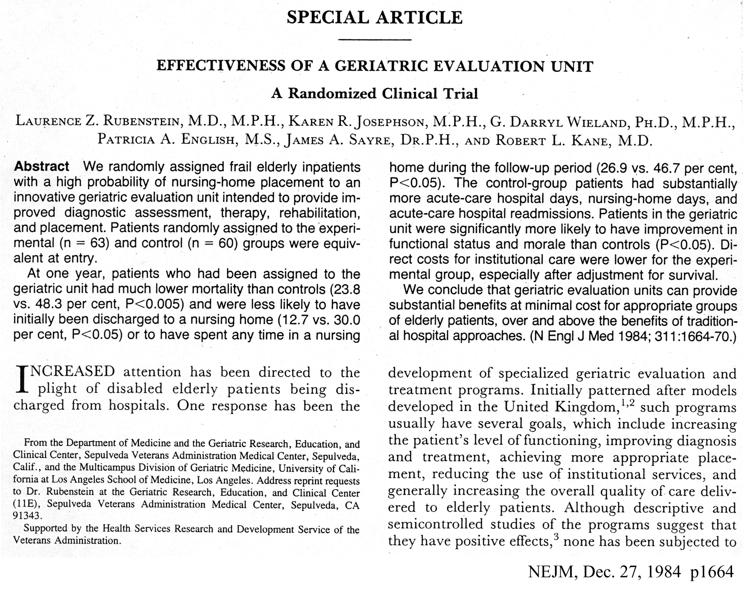

Slide 9
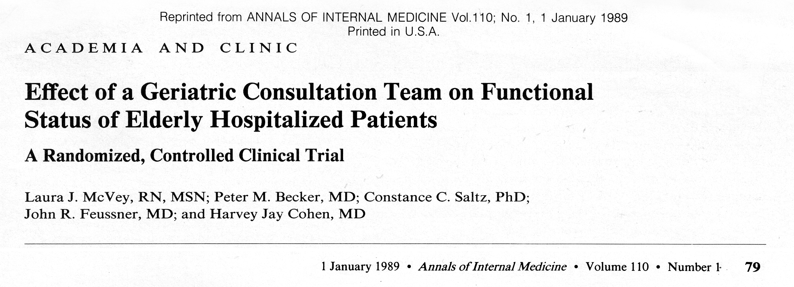

Slide 10
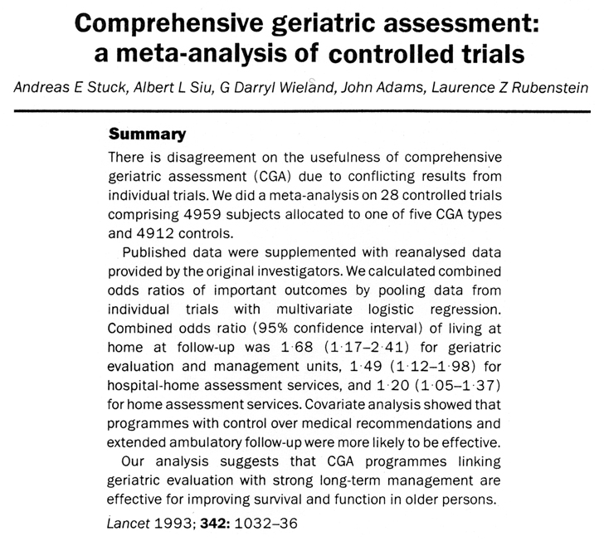

Slide 11
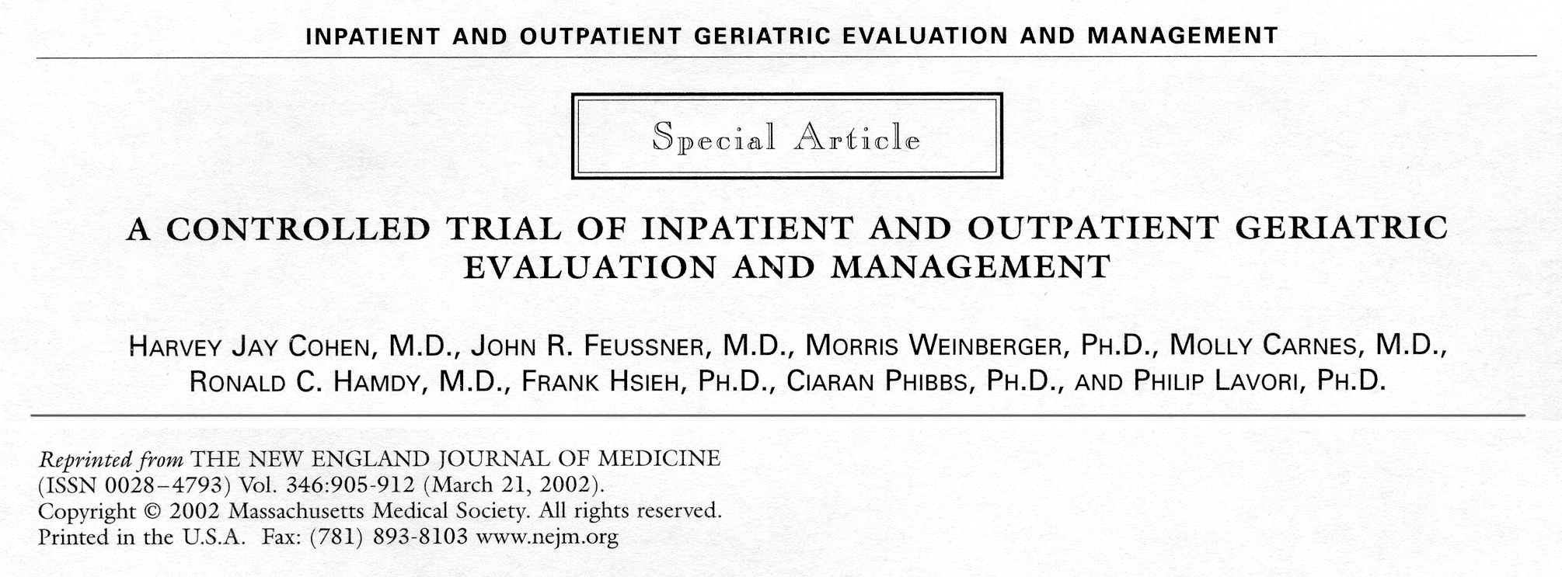

Slide 12
GEM Trial Results
GEMU pts better at Discharge in:
SF36 – Physical Functioning
Bodily Pain – also at 1 year
Energy/Fatigue
General Health
Basic ADL
PPT
2. GEMC better at 1 year in:
energy, general health
SF36 mental health
No difference in mortality at DC or 1 year
Cohen et al NEJM 346:905, 2002

Slide 13
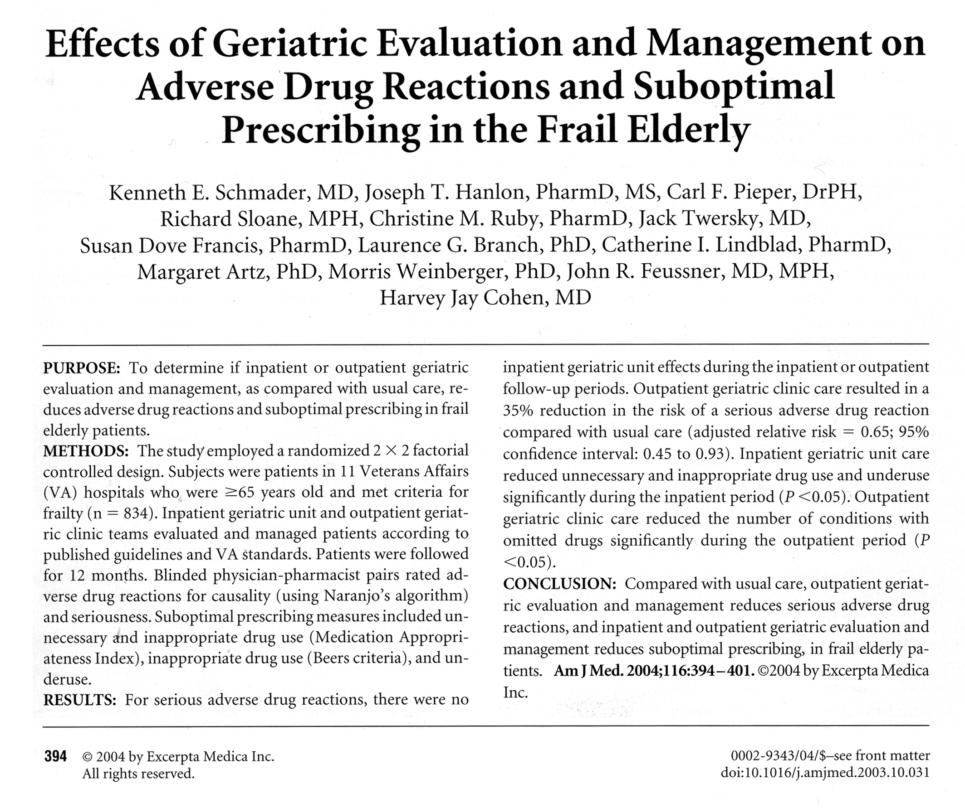

Slide 14
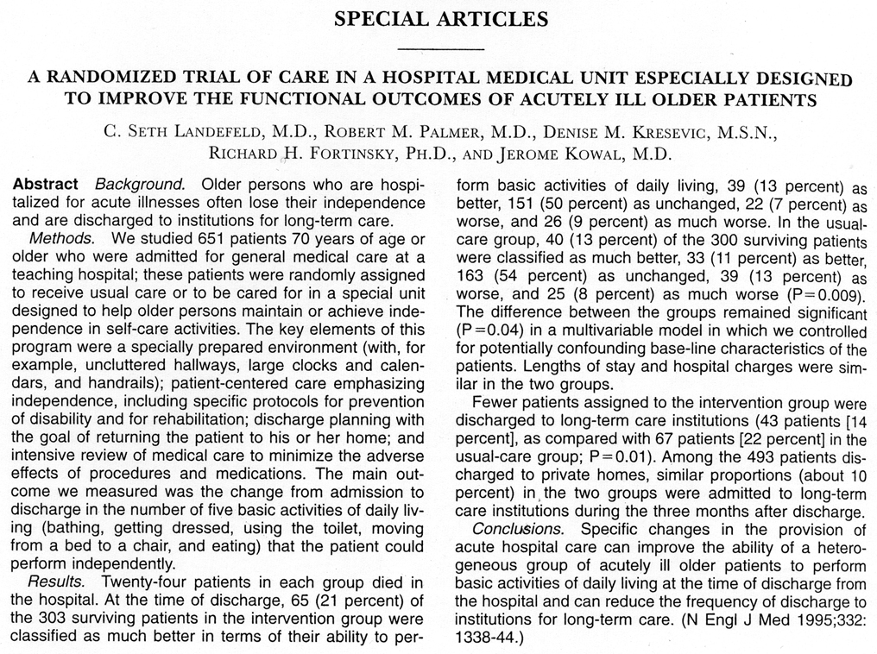

Slide 15
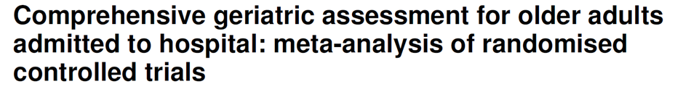
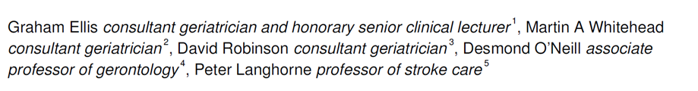
CGA Patients
More likely alive and at home 1.16 (1.05-1.28) p= .003
Less likely in residential care 0.78 (.69-.88) p= < .001
Less likely to experience
deterioration 0.76 (.68-.90) p=.001
Ellis G. et al, BMJ 343:1-10, 2011

Slide 16
CGA Across the Spectrum
Outpatient
  Home: Improve function; mortality
  Clinic-based: Improve function; QOL
  Community care: Reduced admissions; Readmissions
Inpatient:
  Geri Consultation
  Acute Care of the Elderly (ACE)
  GEMU
The Approach
A Way Forward
The Challenge
Results

Slide 17
Comprehensive Geriatric Assessment (CGA)
Multidimensional, interdisciplinary, interprofessional
Diagnostic process
Comprehensive
  Medical
  Psychological
  Functional
Patient centered plan that is used to optimize not just predict or assess
To develop a coordinated and integrated plan for treatment and long-term follow up
Account for social and environmental circumstances
The Approach
A Way Forward
The Challenge
Results

Slide 18
COMPREHENSIVE GERIATRIC ASSESSMENT
FOR OLDER CANCER PATIENTS
Bernabei (2000) – proposed “minimal data set” – extensive
Balducci (1998) – applied principles in outpatient setting
Ingram (2002) – utilized self report pre-visit data
collection for outpatient setting
Repetto (2002) – CGA added information to
performance status in inpatient setting
Hurria (2005) – combination self report and
performance based

Slide 19
GERIATRIC ASSESSMENT FOR ELDERLY CANCER PATIENTS
Goals
Prediction of outcomes, e.g. toxicity
Patient selection
Management during treatment
  Comorbidities
  Medications
Survivorship management
Freyer, Ann Oncol 16: 1795, 2005
Hurria, Oncology 21: 351, 2007
Basso, Crit Rev Onc/Hem 66: 163, 2008
Girre, JGMS 63A: 724, 2008

Slide 20
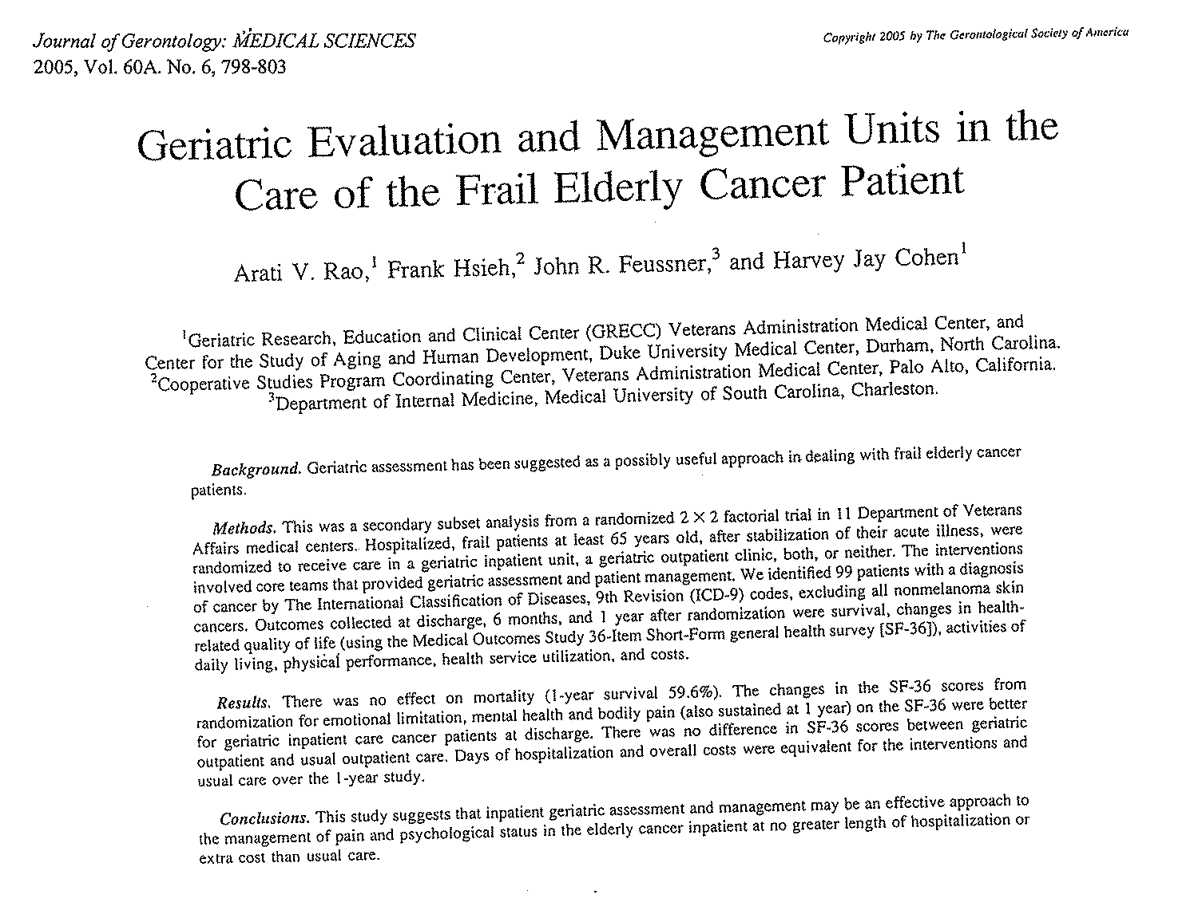

Slide 21
EFFECT OF GEM ON SF-36
In Elderly Cancer Patients
SF-36 scale
GEMU Mean Δ
UCIP Mean Δ
P value
GEMC Mean Δ
UCOP Mean Δ
P value
n = 44
n = 55
n = 53
n = 56
Emotional Limitation
D/C
30.02
2.04
0.01
18.64
9.99
0.44
6 M
38.69
- 0.12
0.001
21.01
13.62
0.56
12 M
41.88
15.50
0.08
26.53
32.21
0.71
Bodily Pain
D/C
28.30
10.41
0.009
21.40
15.05
0.36
6 M
31.16
2.76
0.003
19.62
11.39
0.40
12 M
37.83
9.65
0.006
24.99
23.39
0.88
Mental Health
D/C
5.59
- 6.55
0.01
3.73
- 6.74
0.03
6 M
11.86
- 7.58
0.006
- 1.04
9.43
0.15
12 M
9.89
-3.07
0.11
5.75
1.20
0.58
Rao, JGMS, 60A:798, 2005

Slide 22
CONCLUSIONS
Impressive and sustained effect
on bodily pain
Positive effect on emotional limitations
and mental health parameters
No effect of GEMU on overall survival
and mortality
No difference in costs between GEMU
and usual care of cancer patients
Rao, JGMS, 60A:798, 2005

Slide 23
CGA-CA: OTHER APPROACHES
Clinical Interview – Monfardini S et al,
Cancer 77:395-401, 1996
Takes 27 minutes provider time
Mailed in Questionnaire – Ingram S et al,
J Clin Oncol 20:770-775, 2002
Takes about 40 minutes patient time
Self Administered Questionnaire – Hurria et al,
Cancer 104:1998-2005, 2005
Takes 27 minutes, including 3-4 minutes
provider time

Slide 24
GERIATRIC ASSESSMENT MEASURES SELECTED BASED ON RELIABILITY, VALIDITY, BREVITY
AND PROGNOSTIC VALUE
Domain Measures
____________________________________________________________
Functional Status ADL of MOS Physical Health Scale
IADL {Subscale of the OARS}
Karnofsky Performance Status {Physician-Rated}
Karnofsky Performance Status {Patient-Rated}
Timed Up and Go
Number of Falls in Last 6 Months
Comorbidity Physical Health Section {Subscale of the OARS}
Cognition Blessed Orientation-Memory-Concentration Test
Psychological Hospital Anxiety and Depression Scale
Social Functioning MOS Social Activity Limitations Measure
Social Support MOS Social Support Survey:
Emotional/Information and Tangible Subscales
Seeman and Berkman Social Ties
Nutrition Body Mass Index
% Unintentional Weight Loss in Last 6 Months
Medications List Prescribed, Herbal, OTC
Hurria, Crit Rev Onc/Hem 59:211, 2006

Slide 25
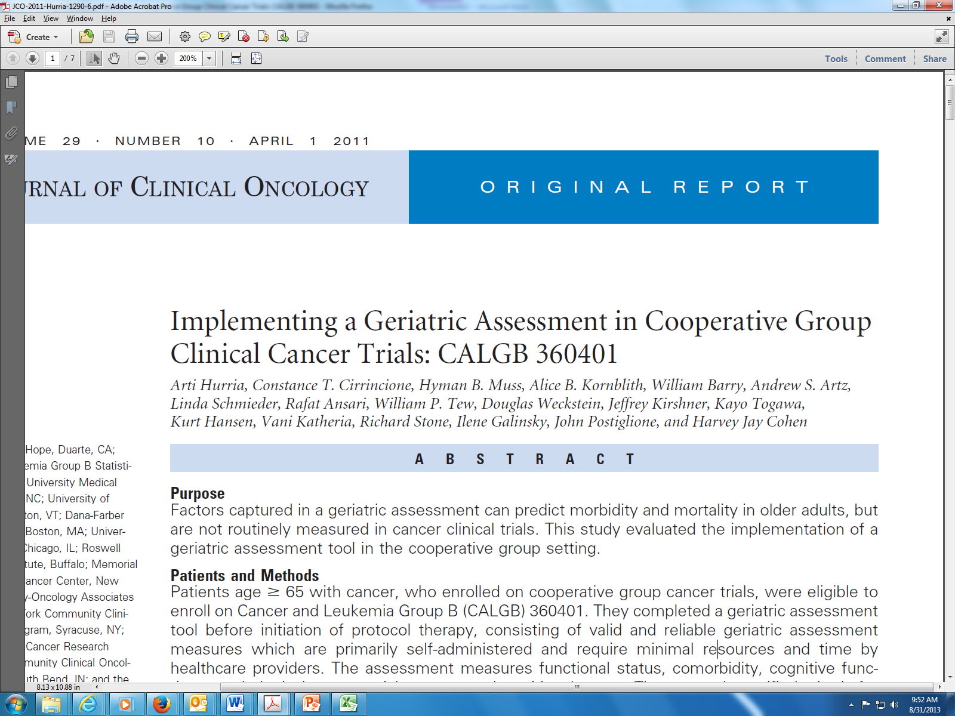
J Clin Oncol 29:1290-1296, 2011
Criteria | Result
Median time: < 40 minutes | 22 minutes
Complete w/out assist: > 70% | 88%
Complete Blessed OMC, KPS, Timed Up and Go: > 80% | 95%
Difficult to understand: < 20% | 5%
Satisfied with length | 92%
No Upsetting questions | 95%

Slide 26
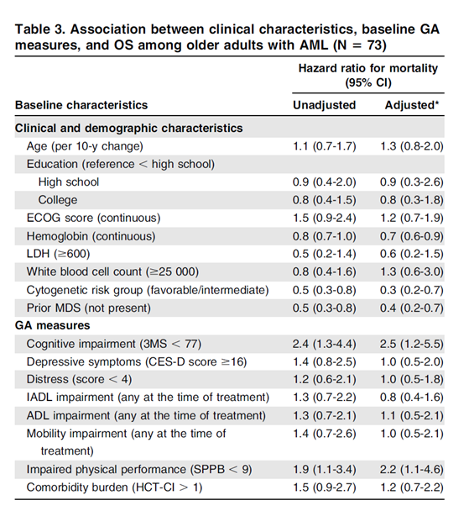
H. Klepin, Blood 121:4287, 2003

Slide 27
Model Performance:
Prevalence of Toxicity by Score
High
(83%)
Medium (52%)
Low
(30%)
Grade 3-5 Toxicities
Total Risk Score
Hurria, JCO 29:3457-3465, 2011

Slide 28
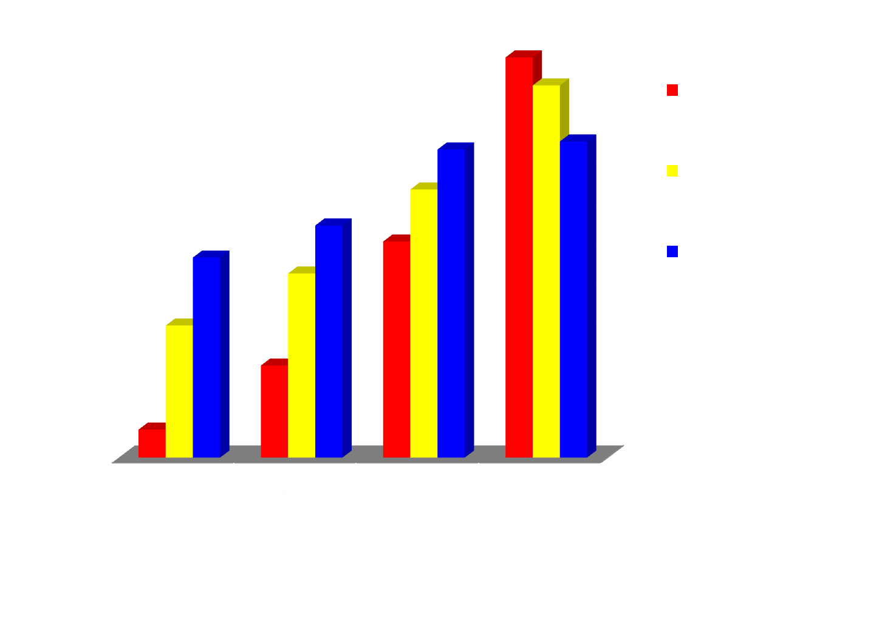
CRASH Model
% Risk
Score
Extermann, Cancer 118:3377-3386, 2012

Slide 29
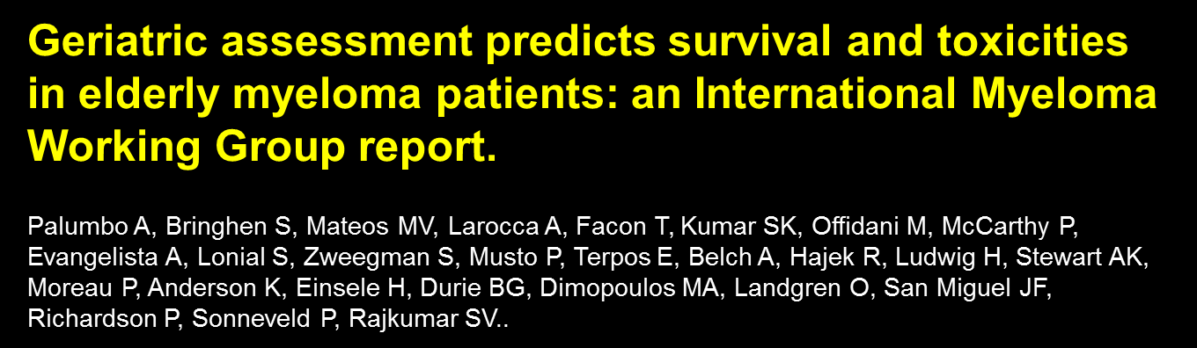
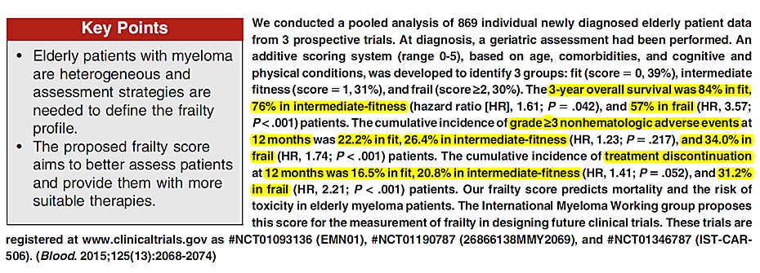
Blood. 125:2068-74, 2015

Slide 30
Geriatric Assessment Screening Tools
aCGA
Barber Questionnaire
Fried Frailty Criteria
Geriatric 8 (G8)
Groningen Frailty Index
Triage Risk Screening Test (TRST)
Vulnerable Elders Survey (VES13)
Lacks Screening Test
NCCN Guidelines V1 2014 Senior Adult Oncology www.nccn.org

Slide 31
GERIATRIC ASSESSMENT FOR ELDERLY CANCER PATIENTS
Goals
Prediction of outcomes, e.g. toxicity
Patient selection
Management during treatment
  Comorbidities
  Medications
Survivorship management
Freyer, Ann Oncol 16: 1795, 2005
Hurria, Oncology 21: 351, 2007
Basso, Crit Rev Onc/Hem 66: 163, 2008
Girre, JGMS 63A: 724, 2008

Slide 32
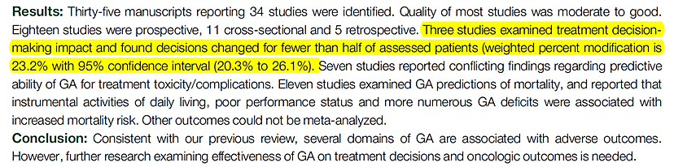
An Update On A Systematic Review Of The Use Of Geriatric Assessment For Older Adults In Oncology
M.T.E. Puts, B. Santos, J. Hardt, J. Monette, V. Girre, E. G. Atenafu, E. Springall and S. M. H. Alibhai
Ann Oncol. 25:307-15. 2014

Slide 33
Relevance of a Systematic Geriatric Screening and Assessment in Older Patients with Cancer: Results of a Prospective Multicentric Study
C. Kenis, et al; Ann Oncol 24:1306, 2013
1967 Cancer Patients ≥ 70 years of age
G8 abnormal in 70% Comprehensive Geriatric Assessment (CGA)
Unknown geriatric problems – 51% ( function, nutrition fatigue, falls, depression, pain most common)
Interventions planned -26% (nutrition, depression fatigue, function most common)
Assessment influenced treatment decision – 25%

Slide 34
What Next?
Enhance the Assessment
CGA to Guide Interventions
Survivorship Management

Slide 35
Characterization of the Older Cancer Patient
Standard History and Physical Exam
Comprehensive Geriatric Assessment
Tumor Characterization
- Histology
- Genetics
Host Biology
- Fluid Biomarkers
- Cellular Biomarkers

Slide 36
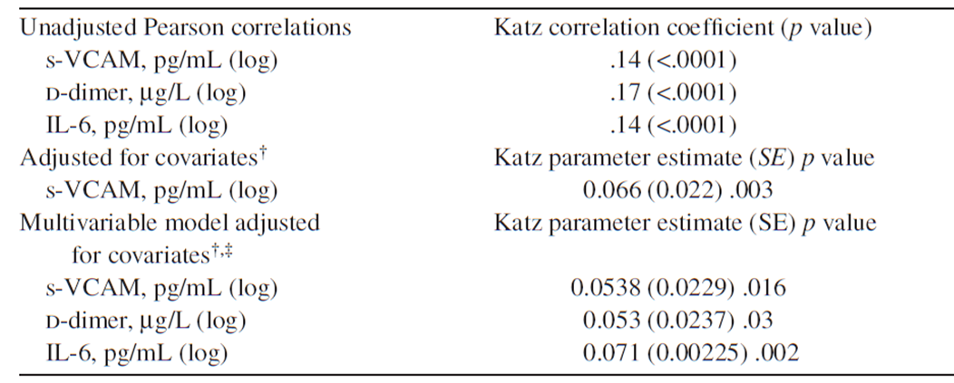
Association of Markers and Function
† Analyses were controlled for age, sex, race, education, body mass index, cognitive status, deep depression, self-rated health, cancer, heart attack, stroke, diabetes, hypertension, sleep difficulties, smoking and alcohol use.
Huffman, J Gerontol 66:1373, 2012

Slide 37
Weighted correlations between circulating biomarkers and physical performance
Circulating Number of N Weighted Fisher’s Z Q Statistic
Biomarker Studies Subjects Correlation
IL-6 6 603 -0.22 -5.39* 9.27
TNFR-2 5 562 -0.19 -4.39* 0.31
D-Dimer 5 562 -0.15 -3.55* 6.76
TNFR-1 5 562 -0.15 -3.47* 2.85
GCSF 4 309 -0.14 -2.36* 3.61
TNFa 6 603 -0.09 -2.27* 5.78
VCAM 4 469 -0.09 -1.97* 3.25
*Adjusted p<0.05 (adjusted for age, BMI, gender, and race).
M. Peterson, J Gerontol A Biol Sci Med Sci. 2015

Slide 38
Summary of Proposed Markers of Functional Age
Marker | Source | Test | Association with Frailty / function | Association with mortality
Chronic inflammatory markers | Serum or plasma | ELISA | Yes (CRP, IL-6, TNF-α, D-dimer, IL1RA | Yes (CRP, IL-6, D-dimer, s-VCAM)
Telomere length | Leukocyte DNA | Q-PCR or southern blot | Yes | Yes
P16^{INK4a} | T lymphocyte RNA | RT-qPCR | No | No
Sarcopenia | CT scan | Commercially available software for body composition analysis | Yes | Yes
Hubbard, Muss, Cohen. JCO, 32: 2611, 2014

Slide 39
Proposed Study Schema
Does access to GA data lead to better decision-making and improve outcomes?
Treatment without GA
Knowledge Arm:
« Usual Care »
MD allowed to choose dose &
regimen (single/ doublet)
Pem +/- Carbo (non-sq)
Gem+/- Carbo (sq)
*Paclitaxel +/- carbo
Primary End Point:
OTU*
Secondary:
Global QoL
Toxicity
Physical Function
OS, PFS, ORR
Geriatric
Assessment
PRO/ QoL
Physical Function
Pt Expectations*
NSCLC
Stage IV
Age > 70
years
ECOG PS 2
R
A
N
D
O
M
(Randomization by site)*
GA knowledge Arm
MD provided GA/ Tox score results &
Implications/ risks
MD allowed to choose dose &
regimen (single/ doublet)
Pem +/- Carbo
Gem+/- Carbo
Paclitaxel+/- Carrbo
Strat factors:
Histology
Gender
Age > 80
* These areas need further discussion
Notes:
39
451 patients with advanced NSCLC aged between 70 and 89 years and a PS of 0 to 2 ,were randomised 1 to 1 between single agent therapy with either vinorelbine or gemcitabine and the doublet of carboplatin and paclitaxel. At progression or in case of excessive toxicity, both arms were switched to erlotinib 150 mg/d.
39

Slide 40
SURVIVORSHIP MANAGEMENT
Problem:
Oncologists do a good job of cancer related management – not so good at comorbidities and functional status
Primary care providers do good job of comorbidites and functional status – not so good at cancer related
Earle, Cancer, 101: 1712, 2004
Mao, JCO 27: 933, 2009
Current care plans concentrate on cancer related issues for the primary care provider

Slide 41
SURVIVORSHIP MANAGEMENT (cont.)
Potential Answers:
Share care, clear communications
Geriatric specific “Survivorship Care Plan” for both oncologists and primary care providers
Oncology providers can use Geriatric Assessment screening to indicate need for further evaluation, e.g. brief CGA

Slide 42


