Slide 1
Cancer and Aging Research Group
U13 Conference
Opening Session
Arti Hurria, MD
Director, Cancer and Aging Research Program
City of Hope
William Dale, MD, PhD
Chief, Section of Geriatrics & Palliative Medicine
University of Chicago
Notes:
Add Dr. Dale’s name too….? yes

Slide 2
U13: Background
  Foundation for research planning in Cancer & Aging
  - 1997 Geriatric Oncology Education Retreat
  - 2001 NIA/NCI workshop “Exploring the Role of Cancer Centers for Integrating Aging and Cancer Research”
Advances in evidence based knowledge in Geriatric Oncology
  Training and mentoring is essential to move the field forward
  - ASCO/ Hartford combined fellowship in Geriatric Oncology - The Cancer & Aging Research Group
Notes:
2

Slide 3
Planning for the Next 10 Years: U13 Grant
“Geriatric Oncology Research to Improve Clinical Care”
Collaboration
    NIA, NCI, The Cancer & Aging Research Group
Mission:
  Review the present level of evidence
  Identify areas of highest research priority
  Develop research approaches to improve clinical care for older adults with cancer
Within the next 10 years

Slide 4
Goals of U13 Grant
  To identify the present level of evidence &
  areas of high research priority in Geri Onc
  To identify strengths in research methodology, from the fields of Geriatrics and Oncology
  To foster collaboration between multidisciplinary scholarly teams
  To foster and promote the research of existing and new investigators in Geriatric Oncology
  To disseminate findings from this conference grant program with easily adaptable recommendations
Research
Methodology
Training
&
Education

Slide 5
Conference Series Topics
3 Successive Conferences:
Year 3:
Design and
Implementation of
Therapeutic Clincial
Trials for Older
and/ Frail Adults
with Cancer
Year 5:
Design and
Implementation of
Intervention Studies
to maintain or
improve the Quality
of Survival of Older
and/or Frail Adults
with Cancer
Year 1:
Biological, Clinical,
and Psychological
Correlates
at the interface of
Aging and Cancer Research
Dissemination
Dissemination:
ASCO Symposium
AGS Symposium
White papers
Web: Slide sets with audio
Dissemination
Dissemination

Slide 6
Conference 1:
Biological, Clinical, & Psychosocial Correlates at the Interface of Aging and Cancer Research
Goals:
  Factors to consider in geriatric oncology research:
    clinical assessment
    biological factors
    psychosocial factors
  Identify and create opportunities for multidisciplinary research
  Disseminate

Slide 7
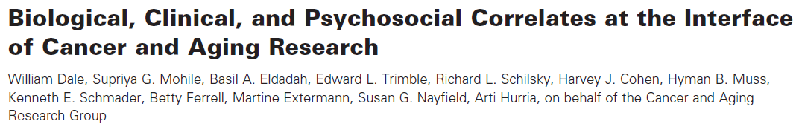
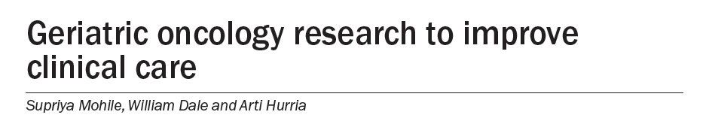
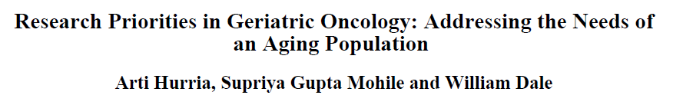
Key Publications from Conference #1
J Natl Cancer Inst, 2012
Nat Rev Clin Oncol, 2012
J Natl Compr Canc Netw, 2012

Slide 8
Conference 2:
Design and Implementation of Therapeutic Clinical Trials for Older and/or Frail Adults with Cancer
Goals:
  Identify gaps in knowledge of cancer therapy in older adults
  Study design of therapeutic clinical trials
  Methods to optimize patient accrual
  Propose opportunities for multidisciplinary studies
  Disseminate

Slide 9
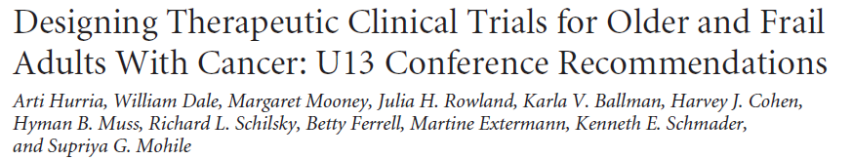
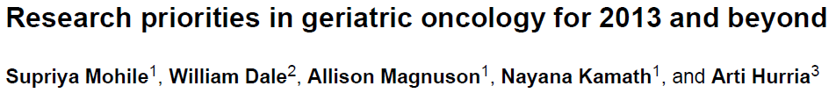
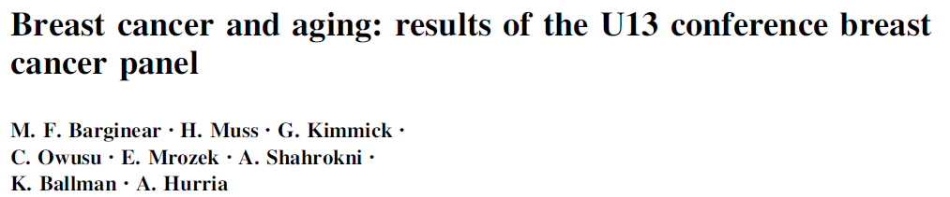
Key Publications from Conference #2
J Clin Oncol, 2014
Cancer Forum, 2013
Breast Cancer Res Treat, 2014

Slide 10
Dissemination Plan
Symposia
  To present key findings and recommendations of conference
  Topic discussion disseminated at:
    - American Geriatrics Society
    - American Society of Clinical Oncology
Manuscripts
  White paper
  Subtopic papers
Press-Release
Audio-Recording and Slides
  Posted on website

Slide 11
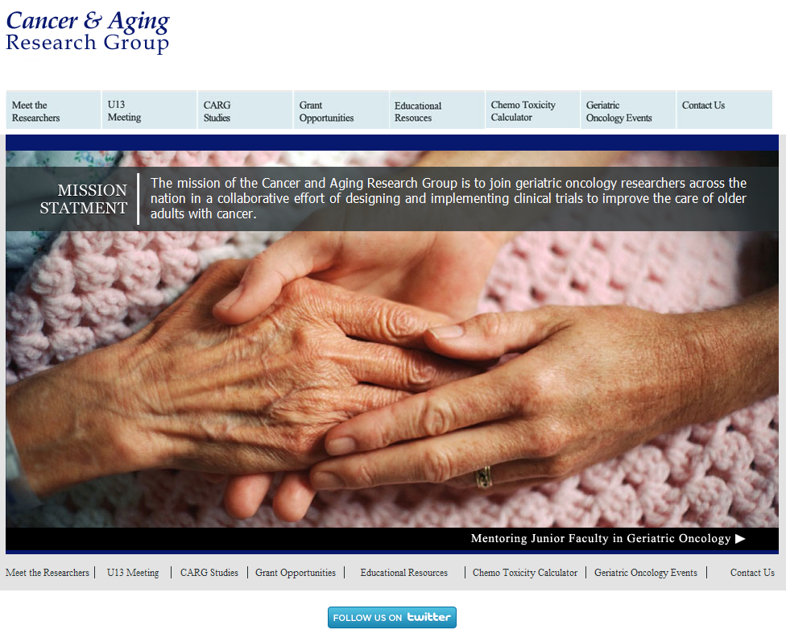

Slide 12
New Investigators
New investigators apply
  Announcements and forms disseminated to:
    Geriatric-oncology training programs
    Previous trainees from Hartford Foundation/ASCO project
    Geriatric oncology interest groups (AGS, CARG, ASCO)
    Recipients of cancer and aging career development awards
New investigators meet senior mentors with similar research interests
Effectiveness captured in evaluations of conferences completed by attendees

Slide 13
Congratulations to the
Young Investigators
Efrat Dotan, MD
Emily Guerard, MD
Tina Hsu, MD
Meghan Karuturi, MD
Deepak Kilari, MD
Melissa Loh, MD
Allison Magnuson, DO
Amy Mackenzie, MD
Ginah Nightingale, PharmD
Ryan Nipp, MD
Rebecca Olin, MD
Carolyn Presley, MD
Erika Ramsdale, MD
Ashley Rosko, MD
Enrique Soto, MD
Grant Williams, MD
Elizabeth Won, MD
Melisa Wong, MD
Nengliang (Aaron) Yao, PhD

Slide 14
U13 Oversight Board
Arti Hurria, MD (PI)
Supriya Mohile, MD, MS (co-PI)
William Dale, MD, PhD (co-PI)
Basil Eldadah, MD, PhD*
Margaret Mooney, MD*
Julie Rowland, PhD
Harvey Cohen, MD (Geriatric Oncology)
Martine Extermann, MD (Geriatric Oncology)
Betty Ferrell, PhD (Nursing Research)
Hyman Muss, MD (Geriatric Oncology)
Richard Schilsky, MD (Oncology)
Kenneth Schmader, MD (Geriatrics)
CARG
NIA
Alliance
NCI
AACR
SIOG
ONS
ASCO
AGS
*Prior Oversight Board Members: Susan Nayfield and Edward Trimble

Slide 15
Thank you!
Geriatrics
Geriatric Oncology
Oncology

